Slide 1
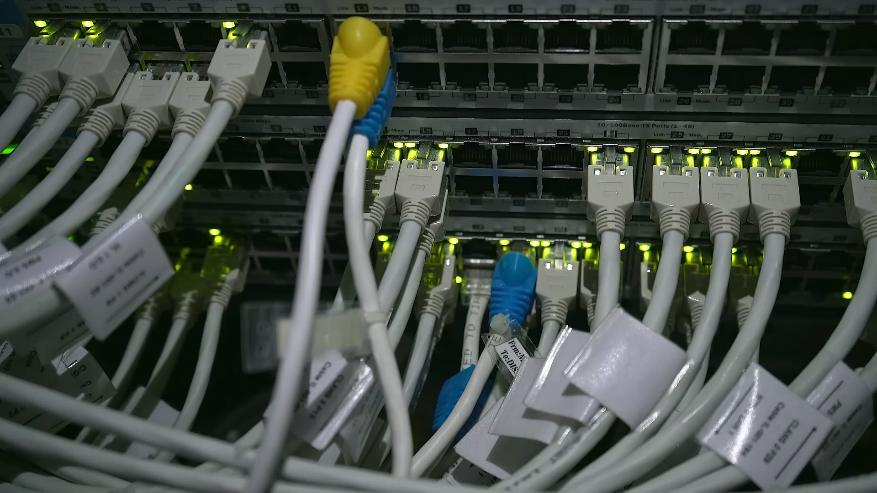
Network Intrusion Detection Analysis
This project analyzes network traffic data in order to identify patterns that may indicate malicious activity. Using data visualization techniques, we explore how different network features behave and how they can help distinguish normal connections from potential attacks.

Slide 2
Network Intrusion Detection
Network intrusion detection systems (IDS) are designed to monitor network traffic and identify suspicious activities or policy violations. These systems analyze network connections and detect patterns that may indicate cyber attacks such as unauthorized access, denial of service, or exploitation attempts.
Modern organizations rely heavily on intrusion detection systems to protect their networks from increasingly sophisticated cyber threats.

Slide 3

Objectives of the Analysis
The objective of this project is to analyze network traffic patterns and identify characteristics that may help detect malicious activity. By visualizing important network features, we aim to better understand how attacks differ from normal traffic behavior.

Slide 4

Dataset Description
The dataset used in this analysis contains network connection records that describe different aspects of network traffic. Each record represents a single connection and includes features such as protocol type, service accessed, connection duration, traffic volume, and several security indicators. These features help analysts detect patterns that may indicate malicious activity.

Slide 5
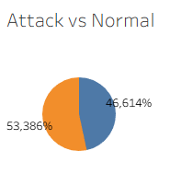
Traffic Distribution
The dataset contains both normal and anomalous traffic. The presence of anomalous connections suggests that the dataset includes various types of potential attacks. Understanding the proportion of attack traffic helps analysts evaluate the level of threat within the network environment. In real-world networks, a large portion of traffic is legitimate, but even a small percentage of malicious activity can cause significant security risks.

Slide 6
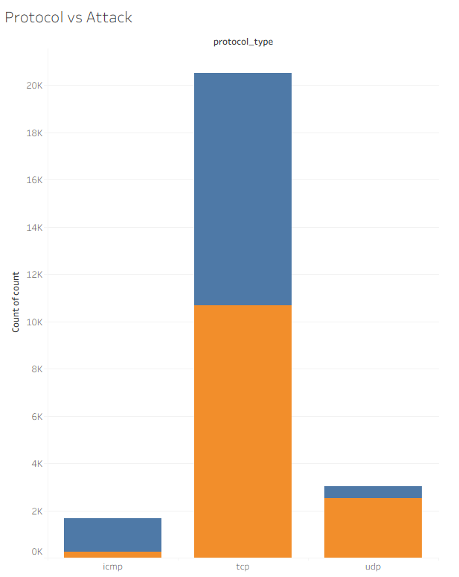
Protocol Analysis
The analysis of network protocols shows that TCP is the most commonly used protocol. TCP is the primary protocol used by many internet services such as web browsing, email communication, and file transfers. Because TCP is widely used, attackers often exploit vulnerabilities within TCP-based services.

Slide 7
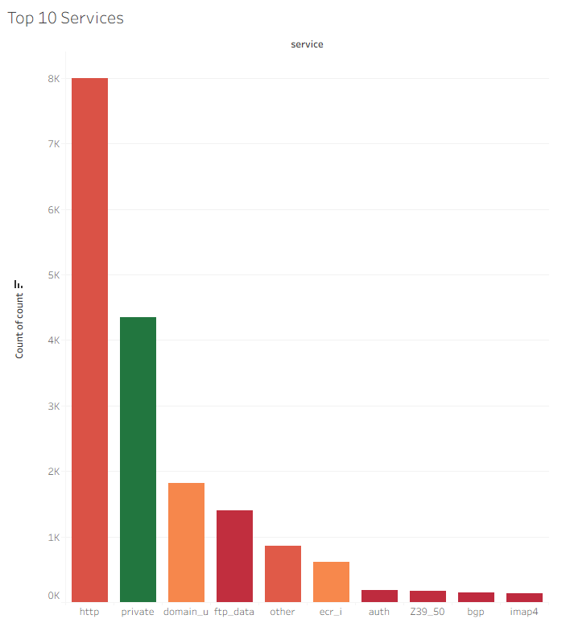
Service Distribution
The most frequently used services include HTTP and private network services. HTTP traffic dominates modern networks because it supports web communication between clients and servers. Attackers often target common services like web servers because they are widely accessible.

Slide 8
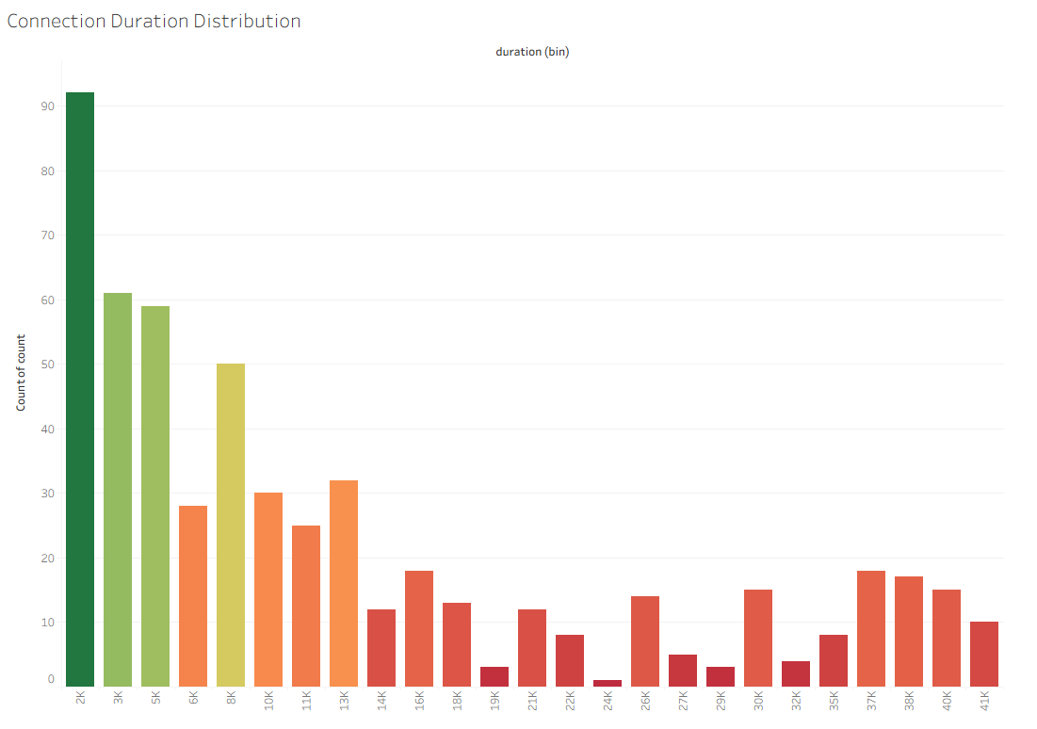
Connection Duration
Most network connections have short durations. Typical internet activities such as loading a webpage or sending a request are completed very quickly. Extremely long or extremely short connections may sometimes indicate suspicious behavior.

Slide 9
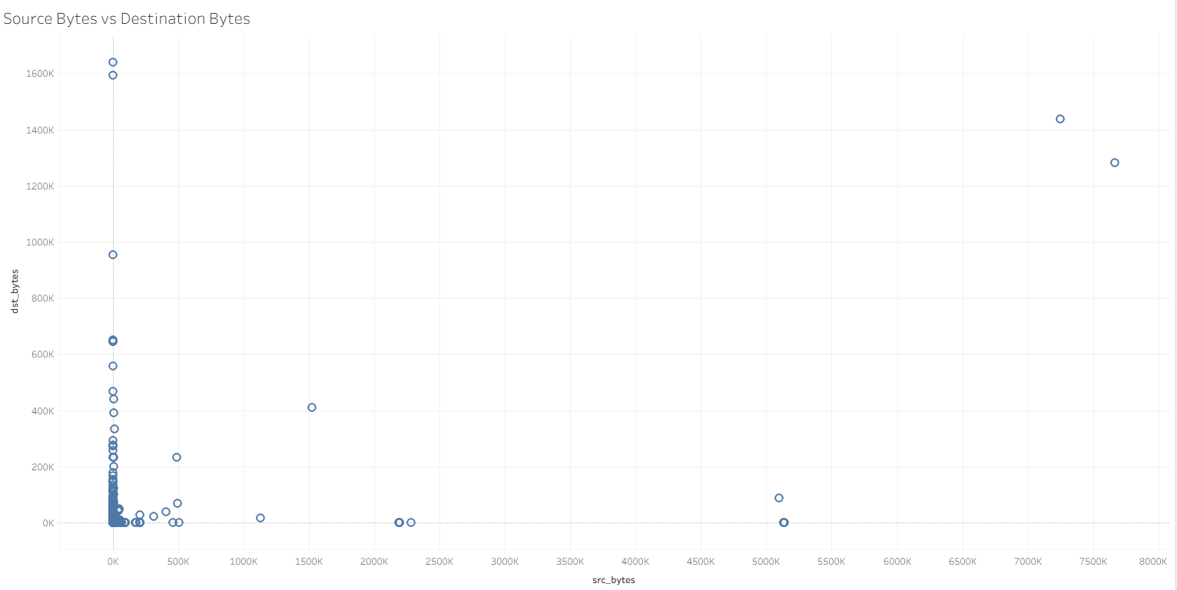
Traffic Volume Analysis
This visualization examines the relationship between connection duration and the amount of transmitted data. Some connections transfer significantly more data than others, which may indicate file transfers or large network operations. Unusual traffic patterns, such as extremely high data transfers, may signal malicious activity like data exfiltration. In some cases, extremely high traffic volumes may indicate data exfiltration, where attackers attempt to transfer large amounts of sensitive information outside the network.

Slide 10
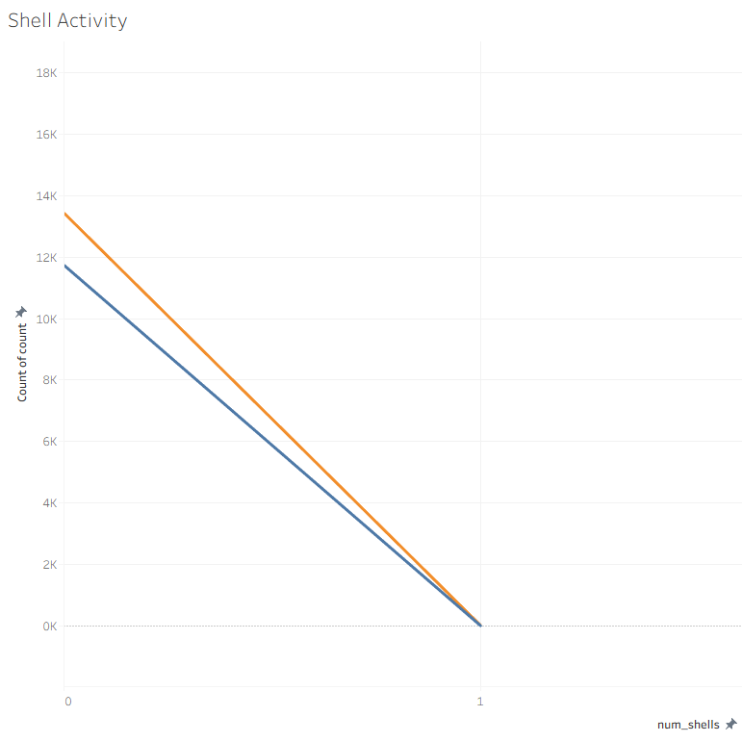
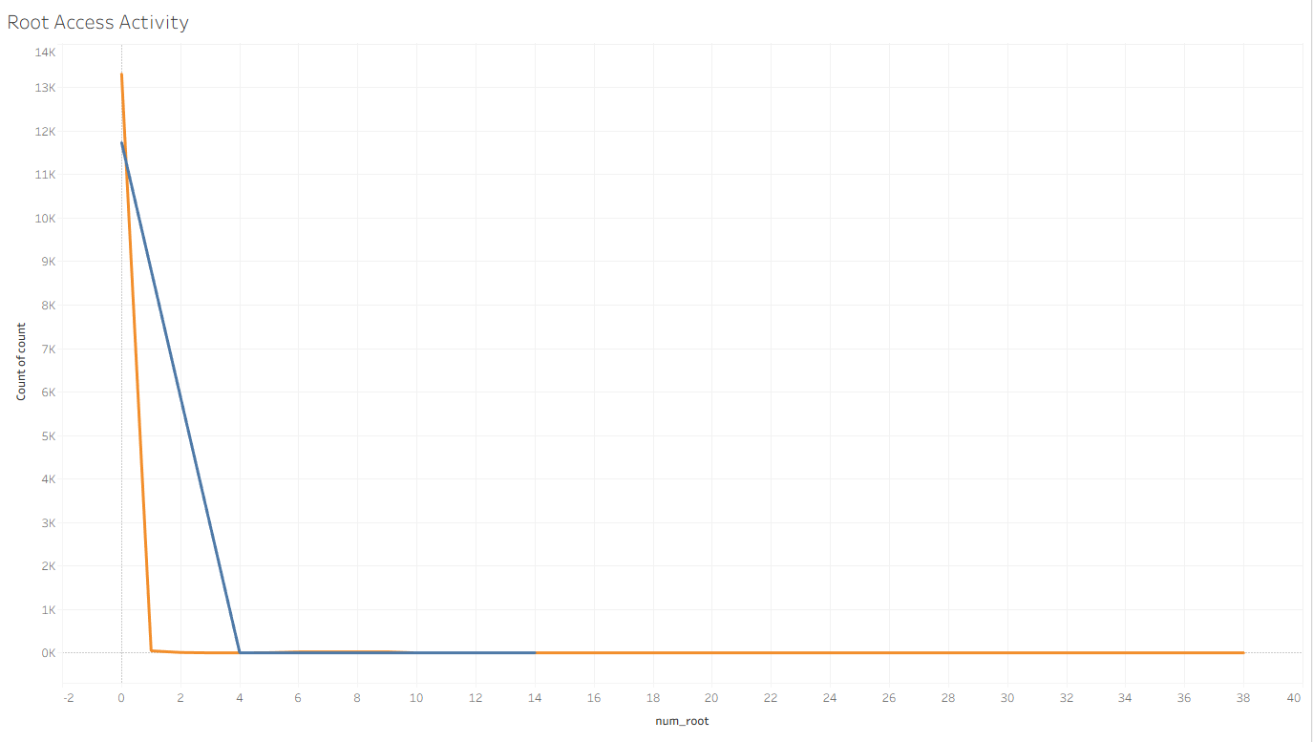
Privileged Access Indicators
Shell access and root operations appear very rarely in the dataset. Root access allows complete control over a system. Unauthorized root access attempts may indicate severe security breaches. Privileged access attempts are important indicators in intrusion detection because attackers often attempt to escalate privileges after gaining initial access to a system.

Slide 11
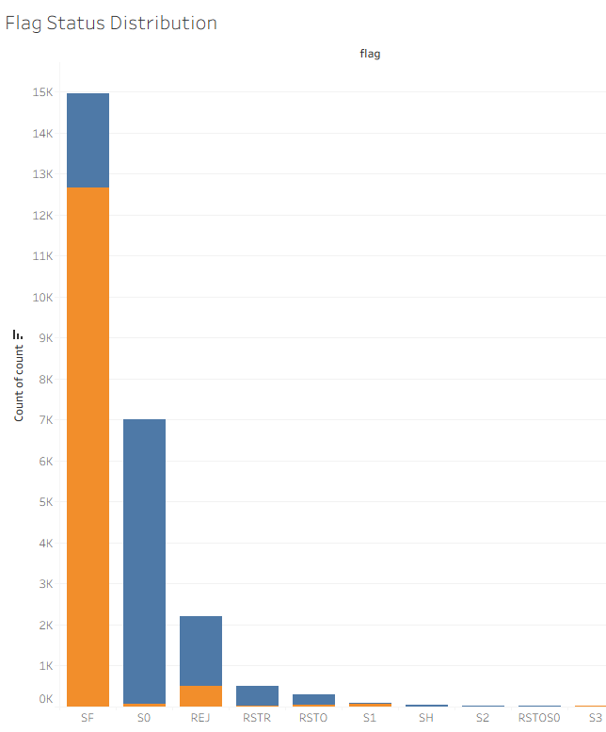
Connection Status Analysis
Most connections are successfully completed. Legitimate network communication typically results in successful connection establishment. Rejected or incomplete connections may indicate scanning or intrusion attempts.

Slide 12

Final Conclusion
The analysis of the network traffic dataset reveals several important patterns. Most connections represent normal network activity, while anomalous traffic displays distinct characteristics such as unusual connection behavior, abnormal traffic volumes, or suspicious login attempts. These patterns highlight the importance of monitoring network activity and using data-driven approaches to detect potential cyber threats. Data visualization plays a critical role in understanding complex network behaviors and improving intrusion detection systems. These insights demonstrate how data visualization can support cybersecurity analysts in identifying suspicious behavior and improving network defense strategies.

